Slide 1
\LaTeX
For Scientific Documentation
By Ammar Taha Mohamedy
Data Plotting Part 1

Slide 2
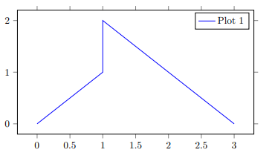
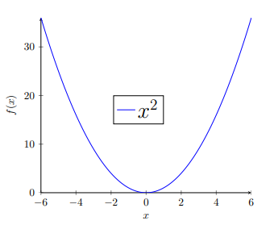
Normal Data Plots (Lined and Curved)

Slide 3
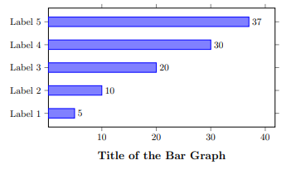
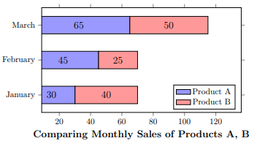
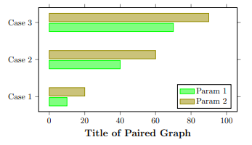
Variations of Bar Graphs

Slide 4
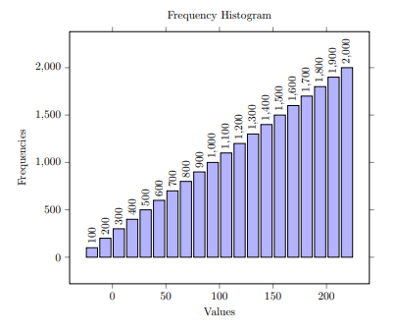
Histogram Visualization

Slide 5
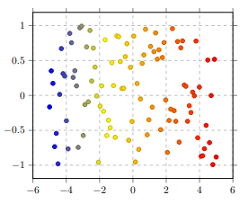
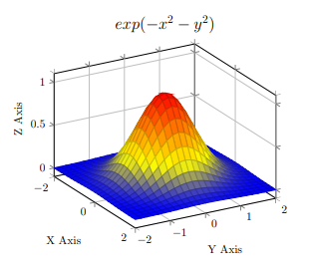
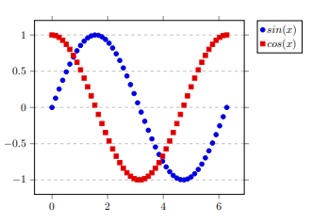
Scatter Plots & 3D Graphs

Slide 6
Thanks for Watching !!

